Slide 1
FELLOWSHIP SITE WEBPAGE
Pittsburgh, Pennsylvania

Slide 2
CONTENT ORDER
To add a new agenda item, go to “Layout” and ”Insert row below”
1 | Title & Featured Image
2 | Who We Are
3 | Simulation Program Overview
4 | Co-Director Bios
5 | Selected Projects/ Accomplishments
6 | Fellowship Collaborators
7 | Selected Alumni

Slide 3
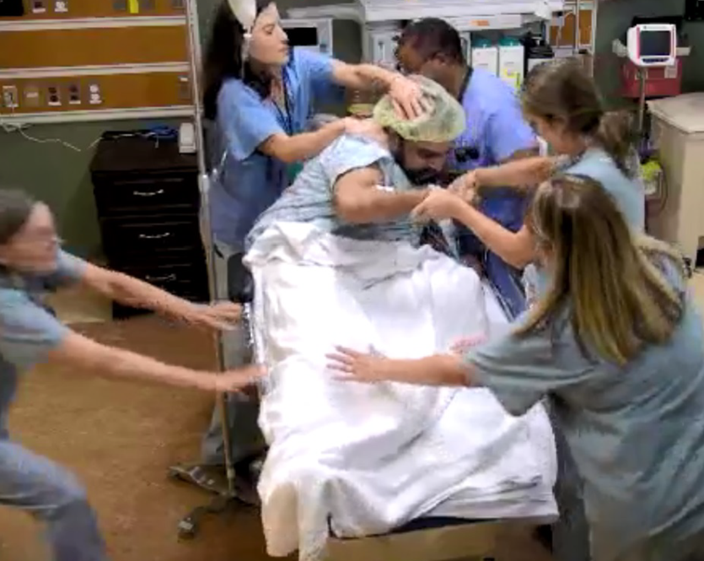
Title: Interprofessional Advanced Fellowship in Clinical Simulation at VA Pittsburgh Healthcare System

Slide 4
Who We Are
Welcome to the Interprofessional Advanced Fellowship in Clinical Simulation (IAFCS) at VA Pittsburgh Healthcare System (VAPHS) in Pittsburgh, Pennsylvania. Aligned with the overarching mission of VAPHS, we are dedicated to honoring America's Veterans with world-class health care, training future providers, and advancing medical knowledge through research. Our vision is to partner with Veterans and their families to optimize their health and quality of life through integrated, innovative, and compassionate care.

Slide 5
Overview of the Pittsburgh VA Health Care System Simulation Program
The VAPHS Clinical Simulation Center is dedicated to the advancement of clinical education and research in the service of excellent patient care. The Center provides a safe learning environment, state of the art educational technologies, and superior faculty.
Our 4400 sq. ft. simulation center is designed to replicate VAPHS hospital facilities, including an operating room, inpatient rooms, and outpatient procedure room, and is flexible enough to accommodate a wide variety of simulations. Current simulation programs focus on procedural skills, clinical team training, communication skills, highly detailed procedural/ surgical skills including virtual training.
Simulations range from individual procedural skills, rapid response teams, system performance including stroke activation and Ebola readiness, mock code, and root cause analysis (RCA).

Slide 6
Meet Our Co-Directors (Attached to email)
Mary Ellen Elias, MSN RN
Simulation Coordinator, Co-Director, Advanced Interprofessional Fellowship in Clinical Simulation at VA Pittsburgh Healthcare System
Mary Ellen Elias serves as adjunct faculty at Waynesburg University in the undergraduate nursing program where she reviewed and updated the nursing policy, quality, and patient safety curriculum to incorporate best practices and more active learning technologies. Ms. Elias has been instrumental in expanding the simulation program at VAPHS into non-traditional domains including behavioral health and crisis management. She has presented at international, national, and local conferences on the use of simulation, standardized patients in system process improvement, and staff education and development. In 2018, Ms. Elias received the 2017 Under Secretary for Health Excellence in Clinical Simulation Training, Education, and Research Champion Award.
Lillian Emlet, MD, MS, CHSE
Co-Director, VA Interprofessional Advanced Fellowship in Clinical Simulation at VA Pittsburgh Healthcare System
Specialties: Critical Care Medicine, Emergency Medicine
Dr. Lillian Emlet has served as the Associate Program Director of the Internal Medicine-Critical Care Medicine fellowship of the Multidisciplinary Critical Care Training Program at UPMC since 2010. Her areas of interest and expertise are in difficult airway management, rapid response interprofessional team training, and palliative end-of-life communication skills. Dr. Emlet is a VitalTalk trained Senior Faculty and teaches empathic communication skills for health care providers to deliver serious news, determine goals of care, and navigate conflict.

Slide 7
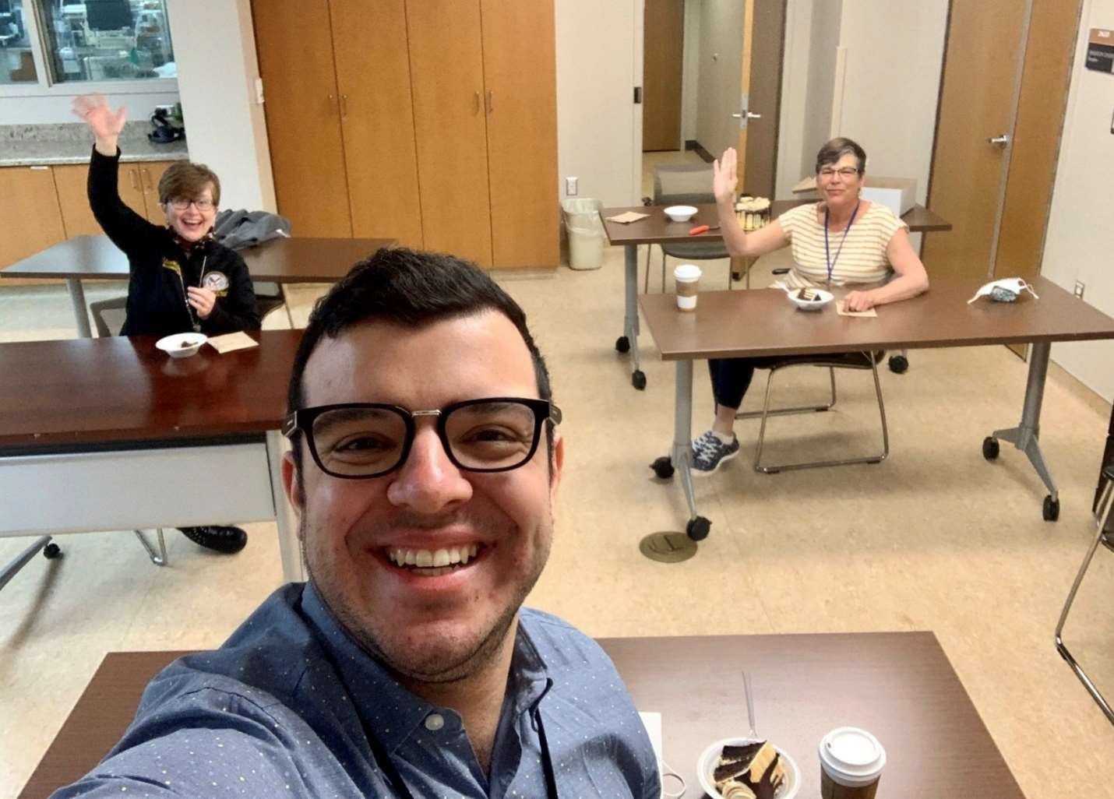
Selected Projects/ Accomplishment
Validation of Airway Hemorrhage Simulation Scenarios (Arshia Ashjaie DDS)
Esophageal Hemorrhage Interprofessional Team Training (Jorge Lara-Gutierrez MD)
Ethics Committee Training (Marianne Burda MD/ Kathy Carter MSN RN)
Mock Deposition Simulation Training (Deanna Blisard MD)
Garage Emergency Evacuation (Dan Wolf MSc)
Veteran Facing Naloxone Training (Suzanne Symons MSW/ Ashley Modany PharmD)
Ebola and Covid Readiness Training
System Integration/ Analysis Projects

Slide 8
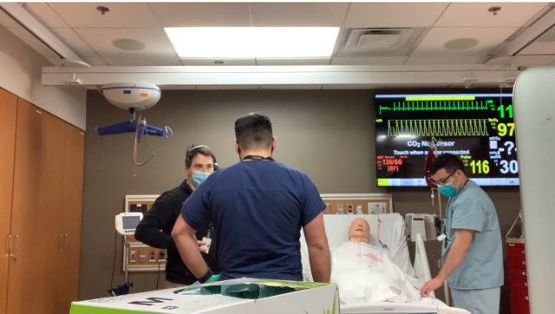
Fellowship Collaborators
Carlow University
Carnegie Mellon University
Chatham University
Duquesne University
Robert Morris University
University of Pittsburgh
The IAFCS at VAPHS has academic affiliations with more 180 interdisciplinary programs across the nation.

Slide 9
Selected Alumni
Marianne Burda, MD, ACOS-E VA Chillicothe
Arshia Ashjaei, DDS, University of Pittsburgh School of Dental Medicine
José Pérez IV, MFA, BFA, Simulation Educator

Slide 10
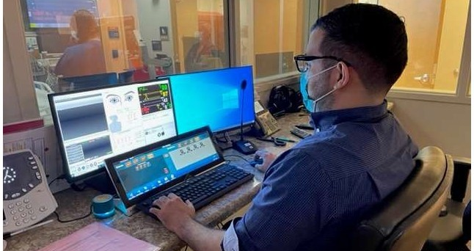
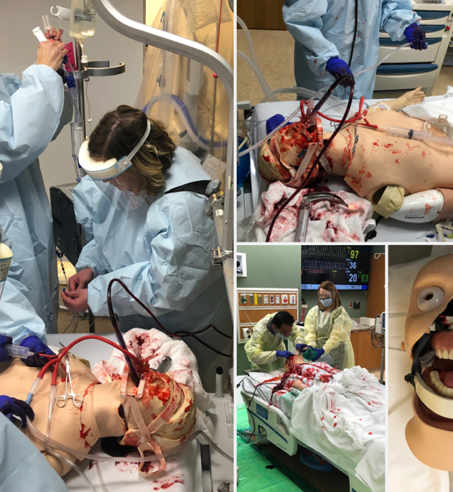
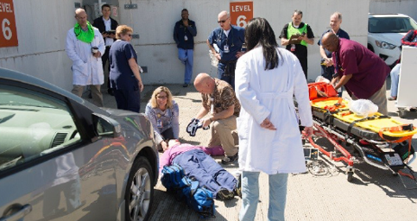

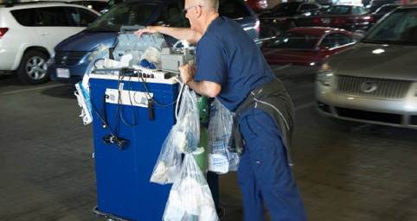
Additional Photos

